Slide 1
D3_1 – Me & Others
IDENTITY
OTHERNESS project
Project Code No: 2015-1-BG01-KA201-014300

Slide 2
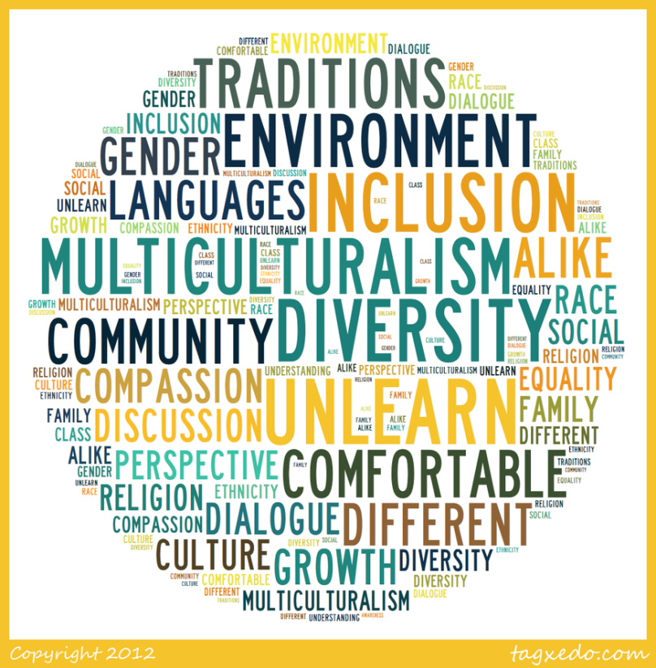
IDENTITY

Slide 3
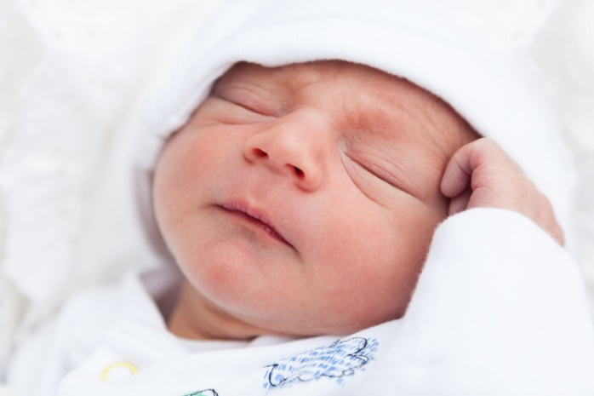
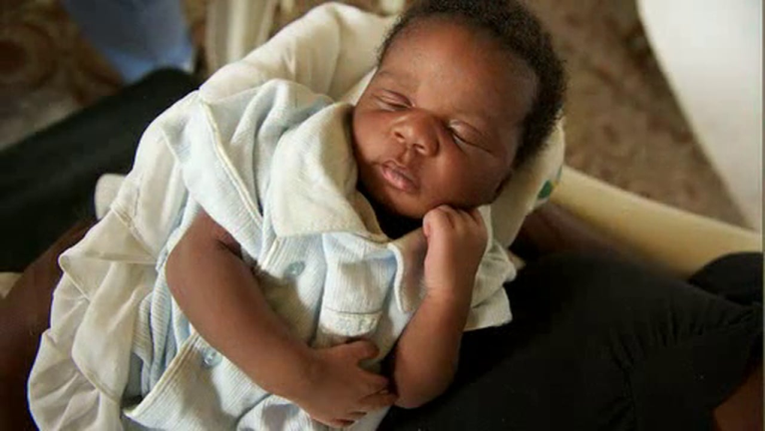
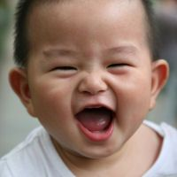
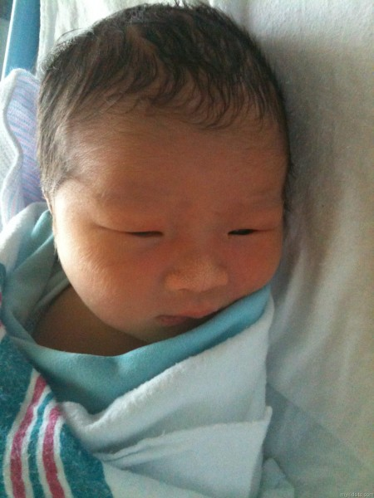
Describe the babies

Slide 4
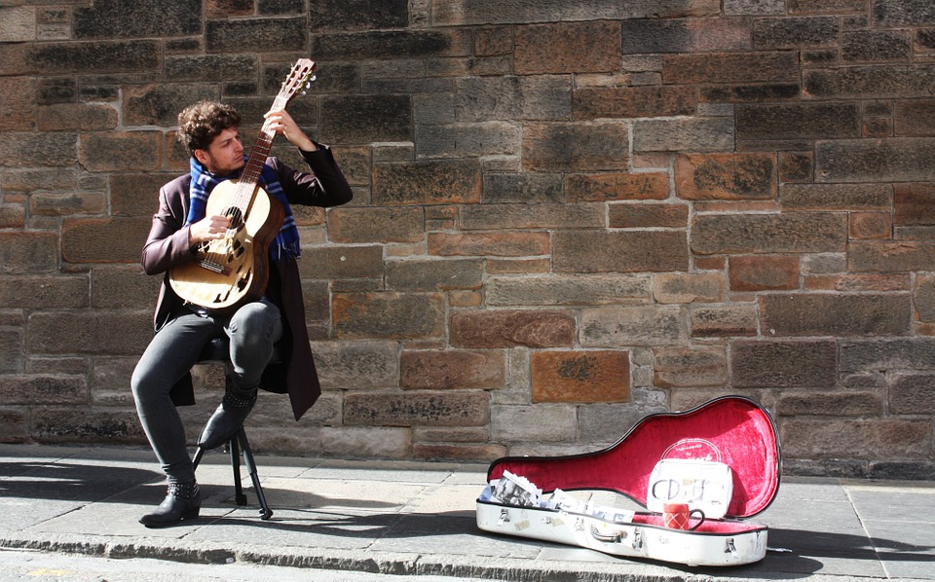
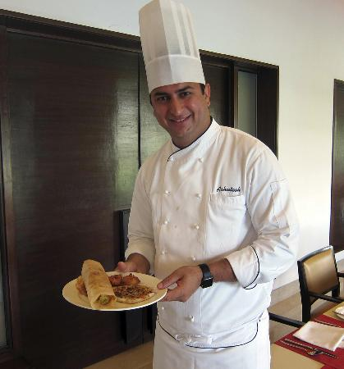
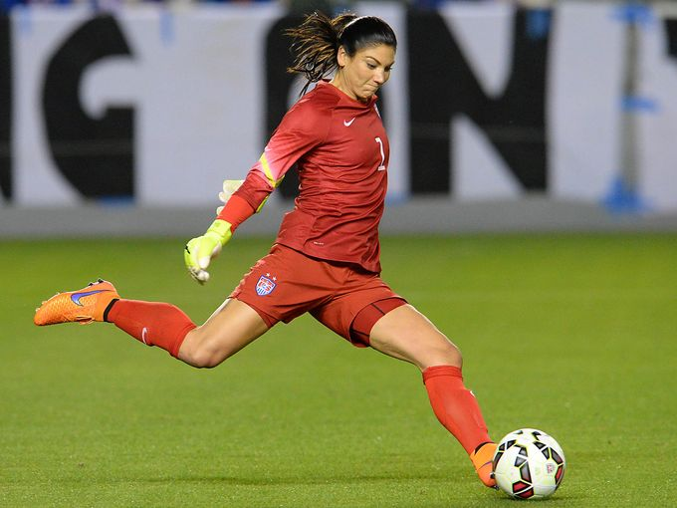
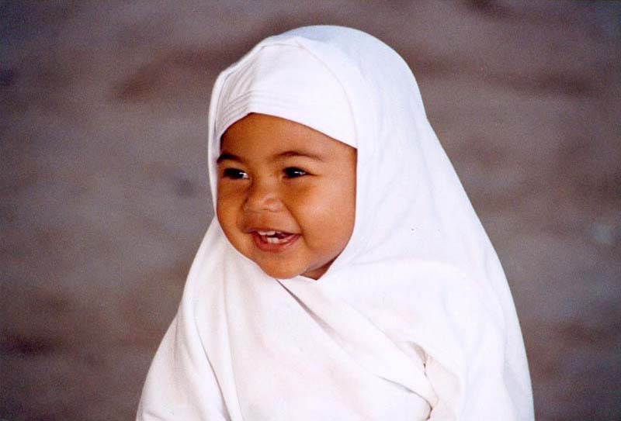
Describe these people

Slide 5
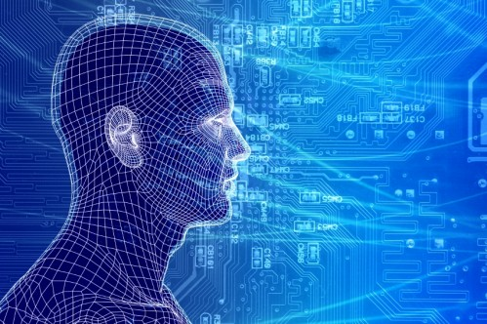
Let’s discuss
What could you describe about the babies?
Why could you describe more things in the adults?
What changes as you grow up?
What things stay the same?
Does a baby or an adult deserve to be treated differently to others?
What could you describe about the babies?
Why could you describe more things in the adults?
What changes as you grow up?
What things stay the same?
Does a baby or an adult deserve to be treated differently to others?

Slide 6
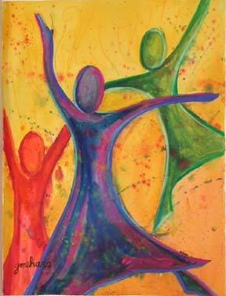
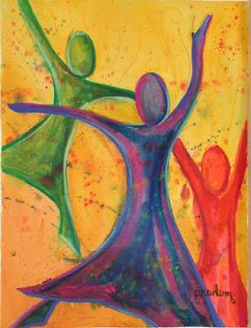
Your identity
Is who you are
Is a set of characteristics that define you as a person
Inborn characteristics of identity: eye colour, race, gender etc.
Developed characteristics (could change with time): personality, interests, beliefs etc.

Slide 7
Created by PROSVETA – SOFIA Foundation, Bulgaria
As a digital resource for the Erasmus +, KA2
OTHERNESS project
Project Code No: 2015-1-BG01-KA201-014300
All images and multimedia objects are within the CC intellectual properties law.
European Commission support for the production of this publication does not constitute an endorsement of the contents which reflects the views only of the authors, and the Commission cannot be held responsible for any use which may be made of the information contained therein.

